Slide 1

PRODUCT REVIEW SENTIMENT ANALYSIS
To analyze customer reviews and classify sentiment (positive, negative, or neutral) using text and metadata, enabling better understanding of feedback, identification of strengths and weaknesses, and improved customer experience through actionable insights.
Presented By : R NITIN

Slide 2
INDEX
Introduction
Data Gathering / Data Refinement
Exploratory Data
Analysis
Features Extraction
Methodology
Experimental Results
Conclusion
Appendices and
References

Slide 3

INTRODUCTION
This project analyzes large volumes of customer reviews from e-commerce platforms to classify sentiments into positive, negative, or neutral using Natural Language Processing (NLP) techniques.
It involves preprocessing unstructured text data (cleaning, tokenization, stopword removal, and feature extraction like TF-IDF) to convert raw reviews into a structured format suitable for analysis.
Machine Learning algorithms such as Logistic Regression, Naive Bayes, or Support Vector Machines are used to automatically detect sentiment, improving speed, accuracy, and scalability compared to manual analysis.
The final output provides actionable insights into customer satisfaction, helping businesses identify product strengths, address negative feedback, and make informed, data-driven decisions.

Slide 4
WORKFLOW
1
6
7
SPLIT TRAIN AND TEST DATA
DATA COLLECTION
MONITOR AND UPDATE
2
5
DATA PREPROCESSING
MODEL SELECTION AND MODEL TRAINING
3
4
EXPLORATORY DATA ANALYSIS
MODEL EVALUATION
4

Slide 5
DATA PREPROCESSING
Handling Missing Values
Removing Duplicates
Data Type Conversion
Text Cleaning
Feature Scaling
We handle missing data through imputation techniques like mean or median for numerical features, and mode or for categorical features, ensuring minimal distortion of patterns in the dataset.
Identified and removed duplicate rows to avoid biased predictions.
Some numerical-looking columns were actually categorical, so they were converted into the appropriate data types.
Text cleaning in Natural Language Processing is the process of converting raw text into a clean, structured format by removing noise and standardizing it, making it suitable for analysis and improving model performance.
Applied Standard Scaler or min-max scaling to ensure features are on a similar scale, improving model performance.

Slide 6


Exploratory Data Analysis
Exploratory Data Analysis (EDA) is the process of analyzing and visualizing a dataset to understand its key characteristics before applying machine learning models. It helps identify patterns, trends, missing values, outliers, and relationships between variables.
Using visuals helped us see the data clearly, understand the clinical data relationship with each other, and pinpoint factors that plays vital role in predictions of Breast Cancer disease.
Insights from EDA help you decide which features are most important for building models and how to prepare them to improve performance.
Some features may be closely related to each other. We use a heatmap to check for strong connections between variables. If two features provide similar information, we may remove one to avoid redundancy.
Univariate analysis looks at one feature at a time to understand its distribution using simple statistics and graphs like histograms and bar charts.
Bivariate analysis examines the relationship between two variables and graph like scatter plots, pair plots. This helps us find important factors that may affect predictions.

Slide 7
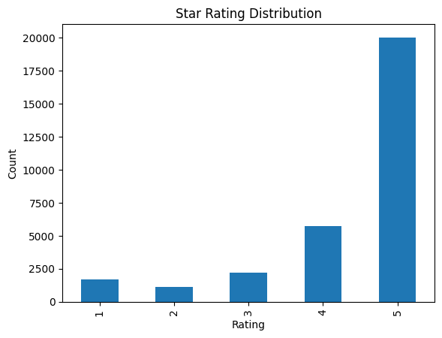
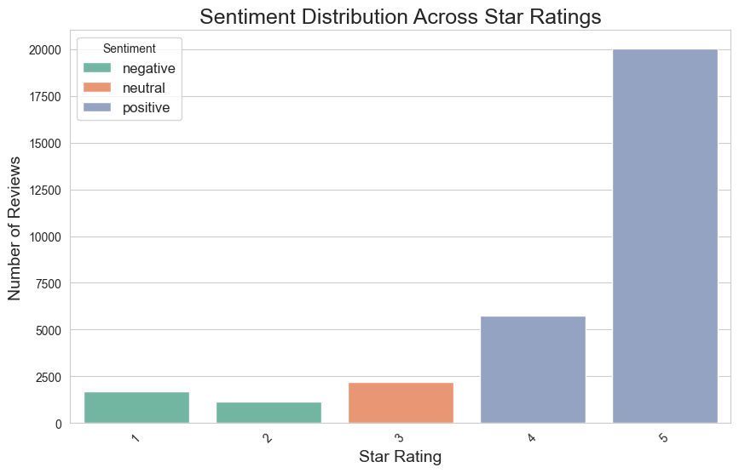
Star Rating Distribution
Sentiment Distribution Across Star Ratings
There is a strong relationship between star ratings and sentiment, where low ratings (1–2) mostly show negative sentiment and high ratings (4–5) show positive sentiment.
Positive sentiment dominates the dataset, especially in 4-star and 5-star reviews, indicating high customer satisfaction.
Neutral sentiment is mainly present in 3-star ratings, reflecting mixed or average customer experiences.
Negative sentiment is concentrated in 1-star and 2-star reviews, highlighting dissatisfaction and potential issues.
There is a clear upward trend, where sentiment becomes more positive as the star rating increases.
The alignment between ratings and sentiment shows that the model is accurately capturing customer opinions from text data.

Slide 8
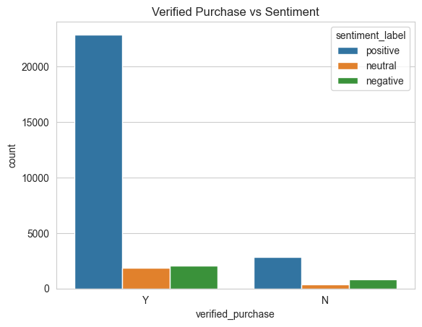
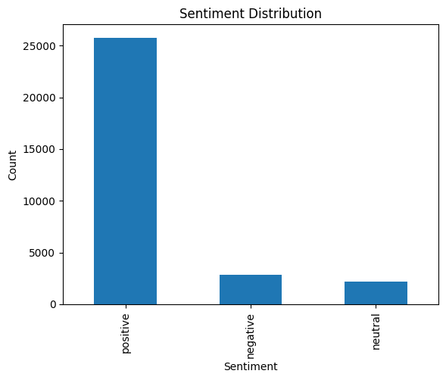
Verified Purchase vs Sentiment
Sentiment Distribution
Positive sentiment dominates the dataset, with a significantly higher number of reviews compared to other categories.
The large gap between positive and negative sentiment indicates strong overall customer satisfaction.
Negative sentiment is relatively low, suggesting fewer dissatisfied customers but still highlighting areas for improvement.
Neutral sentiment is the least or moderately represented, showing that most customers have clear opinions rather than mixed feelings.
The distribution is highly skewed towards positive reviews, which can positively influence brand perception and sales.
Despite fewer negative reviews, analyzing them can provide valuable insights into product issues and customer pain points.

Slide 9
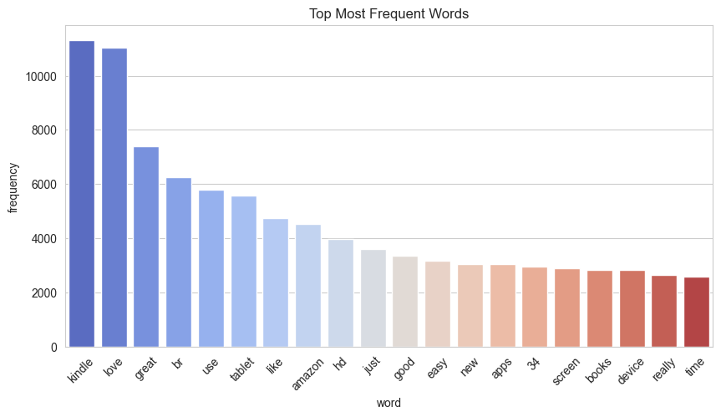
The graph represents the most frequently occurring words in customer reviews, helping identify what users commonly talk about. This gives insight into both customer interests and product perception.
The highest frequency words like “kindle” and “love” indicate that the product is widely discussed and strongly appreciated by users, reflecting a high level of engagement and satisfaction.
Positive words such as “great”, “good”, “easy”, and “like” appear frequently, showing that customers are generally happy with the product’s performance, usability, and overall experience.
Words like “tablet”, “device”, “screen”, and “hd” highlight that customers focus on technical features and specifications, suggesting that product quality and functionality are key discussion points.
The presence of words such as “books” and “apps” indicates the primary use cases of the product, especially for reading and using applications, which aligns with the purpose of devices like Kindle.
Platform-related words like “amazon” suggest that some reviews also include feedback about the purchasing experience or brand trust.
Overall, the graph shows that customer reviews are largely positive and feature-oriented, with very few negative or complaint-related words appearing frequently.
This supports the conclusion that the product has a strong market acceptance.
Top Most Frequent Words

Slide 10
TRAIN – TEST SPLIT
We divided the data into training (80%) and testing (20%) sets.
Setting a random state ensures consistent results and using stratify=y maintains a proportional distribution of the target variable in both sets.
SPLITING THE DATA INTO X & Y
We divided the dataset into two parts: X and y.
"X" typically represents the independent Variables, and "y" represents the Dependent (target variable) that we want to predict or understand.
Network Traffic Network

Slide 11
Model Selection
Logistic Regression
SVM
Extra Tree
Naive Bayes
LightGBM
Logistic Regression is a statistical method used for binary classification. It is valued for its simplicity and effectiveness in modeling the relationship between input variables and the probability of a specific outcome.
Support Vector Machine (SVM) is a supervised machine learning algorithm used for both classification and regression tasks. It works by finding the optimal hyperplane that separates data points into different classes with the maximum possible margin.
Extra Trees (Extremely Randomized Trees) is an ensemble machine learning algorithm based on decision trees. It is used for both classification and regression tasks and is known for its speed and accuracy.
Naive Bayes is a supervised machine learning algorithm based on Bayes’ Theorem, used mainly for classification tasks. It assumes that all features are independent of each other (hence the term “naive”), even though this may not always be true in real-world data.
LightGBM (Light Gradient Boosting Machine) is an advanced machine learning algorithm based on gradient boosting. It is designed for speed and efficiency, making it ideal for handling large datasets with high-dimensional features.
Note : - In machine learning, there are many models, but I have chosen the best model that is most suitable for this dataset to ensure optimal performance.
Network Traffic Flow

Slide 12



Model Evaluation
Experimental Results :
MODEL’S | ACCURACY % | PRECISION | RECALL | F1-SCORE
Logistic Regression | 88.1 | 0.89 | 0.88 | 0.88
Naïve Bayes | 88.4 | 0.86 | 0.88 | 0.87
Extra Tree | 82.8 | 0.86 | 0.82 | 0.84
SVM | 88.0 | 0.88 | 0.88 | 0.88
Light GBM | 87 | 0.88 | 0.86 | 0.87
Extra Tree :
Extra Tree excels with (82.8%) accuracy, precision (1.00) and recall same .
SVM and Light GBM :
All algorithms maintain a precision of ( 0.88 ) with the only difference being in accuracy. The highest accuracy is achieved by SVM at (88%) .
Logistic Regression :
Logistic Regression achieves (88.1%) accuracy and precision ( 0.89) and recall achieves ( 0.88) .
Understanding
Model Selection Insight
Why should I choose Logistic Regression over other model ?
Logistic Regression is the best choice because it provides a strong balance between accuracy, generalization, interpretability, and computational efficiency, making it highly suitable for sentiment analysis tasks using textual data.
Precision: The accuracy of the model when it claims to have found something.
Recall: Recall: The ability of a model to find all the relevant cases
F1 Score: A balance between recall and precision, useful when both false positives and false negatives need to be minimized.

Slide 13
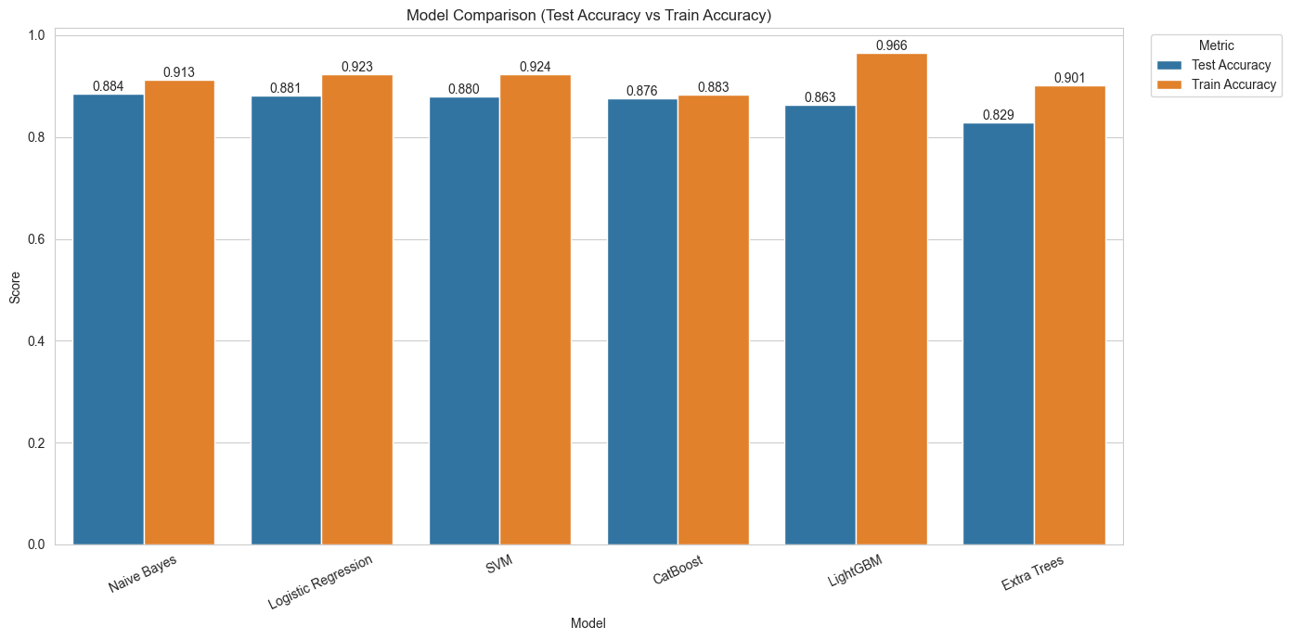
Model Comparison

Slide 14


Conclusion
Key Findings
Logistic Regression model demonstrated the optimal accuracy of 99.9% in predicting sentiment analysis of product reviews .
The study utilized a Product Review dataset and applied multiple machine learning models using Jupyter Notebook to analyze and classify customer sentiment.
Some models showed strong performance, with accuracy ranging from 88.4% (Naïve Bayes) to 82% (Extra Tree) .
Limitations
The study is based on a single, relatively small product review dataset, which may limit its generalizability across diverse products, categories, and price ranges.
The model primarily relies on textual features and basic metadata, potentially overlooking deeper contextual aspects such as sarcasm, user intent, evolving language patterns, and domain-specific sentiment variations.
The model requires further validation on independent and larger real-world datasets to ensure robustness, scalability, and practical applicability.
Future research
To improve the accuracy and reliability of sentiment analysis, future research should focus on building robust and interpretable models. It is important to address challenges such as noisy text, fake reviews, and class imbalance, while incorporating advanced techniques like deep learning and contextual embeddings. Validating the model on diverse, real-world datasets will further enhance its effectiveness for data-driven decision-making.

Slide 15
Thank You

